Slide 1
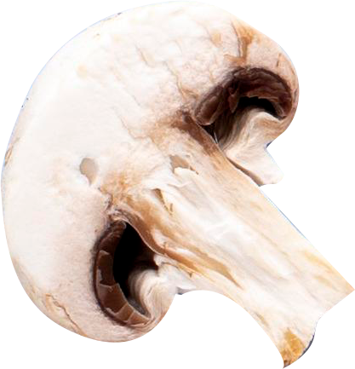
Mushroom Classification & Semi-supervised Learning
Group 2 Members:
Binaya Kumar Chaudhary
Hemant Raj Singh
Rohan Aryan-C0912902
Sani Asnain-C0906772
Shreya Baral (C0913115)

Slide 2
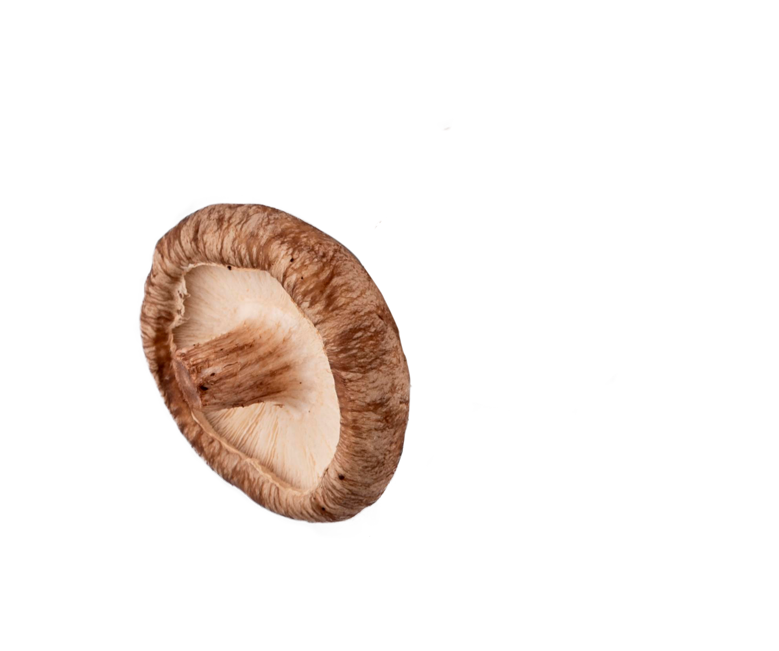


Table of Content
Data Identification
Data Acquisition and Filtering
Data Validation and Cleansing
Data Aggregation and Representation
Data Analysis
Model Building
Business Case Evaluation
Utilization of Analysis Results

Slide 3
“In 2022, sales of fresh and processed mushrooms amounted to approximately 694.47 million Canadian dollars, an increase from around 653.51 million the previous year.”

Slide 4
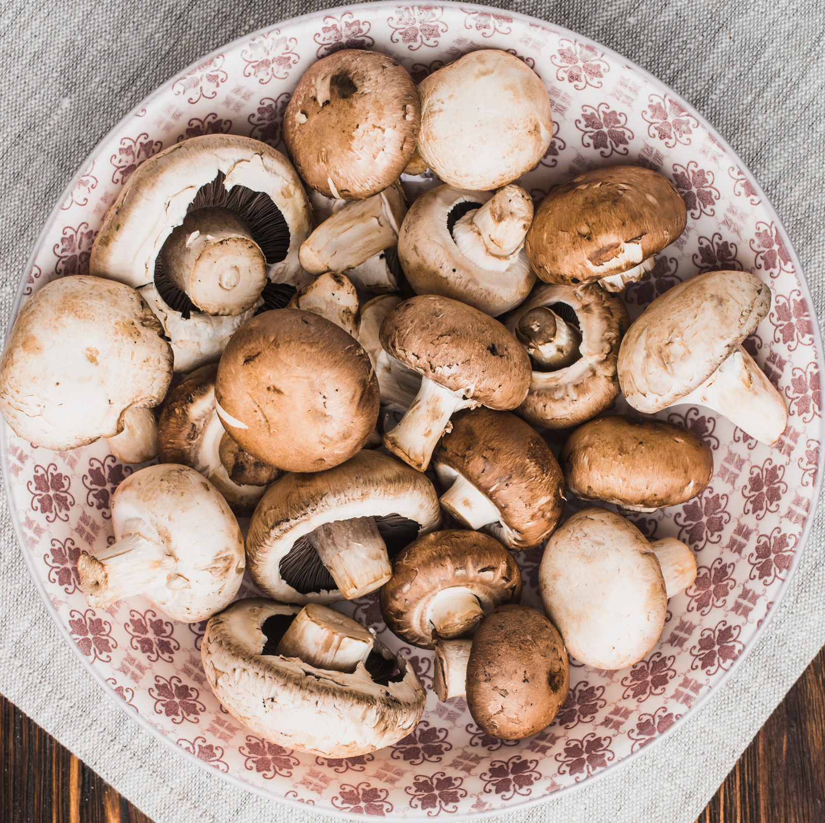
Business Case Evaluation
Why classify mushrooms can be helpful?
Risks of consuming Toxic Mushrooms
The need for accurate and Efficient Testing
Improved Food Safety for Consumers
Reduced Healthcare costs from Mushroom Poisoning
Notes:
Consuming toxic mushrooms can lead to severe illness, organ failure, and even death. Predicting safety ensures we can distinguish edible from harmful species.
Current methods of mushroom testing can be time-consuming, costly, and prone to errors. A predictive model can provide faster and more reliable results.
Using the model's predictions, consumers can make informed decisions, reducing the risk of consuming toxic mushrooms and promoting overall food safety.
By preventing mushroom-related illnesses, healthcare costs can be significantly reduced, benefiting both individuals and public health systems.

Slide 5



Data Identification
A mushroom containing 173 species (353 mushrooms per species) .
Obtained from the UCI dataset repository.
Can be accessed at the following link: https://archive.ics.uci.edu/dataset/848/secondary+mushroom+dataset.

Slide 6
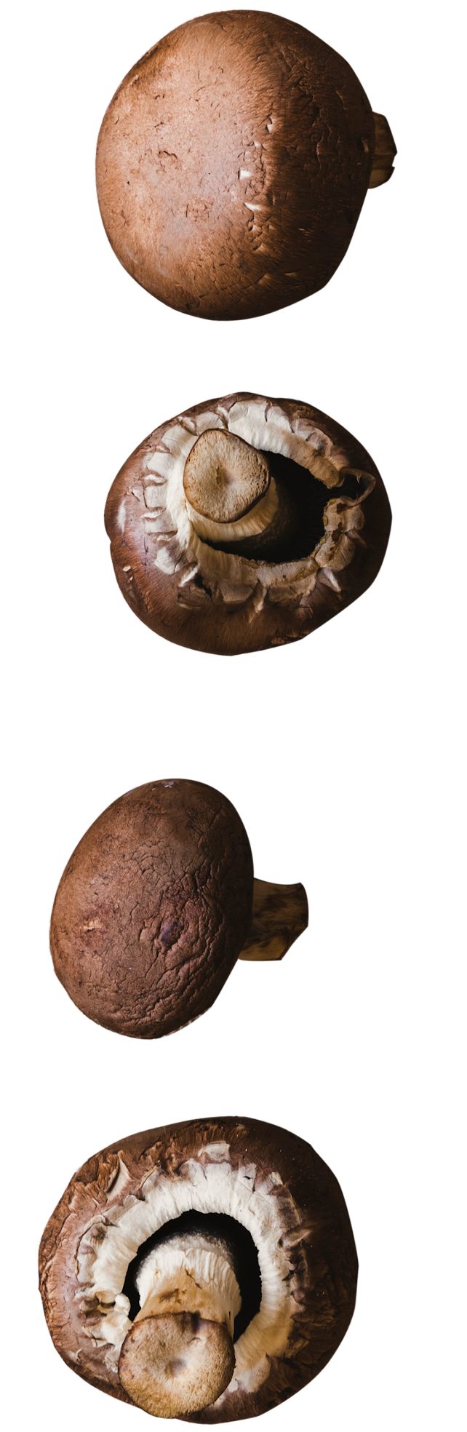
Dataset Features
Class information:
class: poisonous=p, edible=e (binary)
Variable Information: (n: nominal, m: metrical; nominal values as sets of values)
cap-diameter (m): float number in cm
cap-shape (n): bell=b, conical=c, convex=x, flat=f, sunken=s, spherical=p, others=o
cap-surface (n): fibrous=i, grooves=g, scaly=y, smooth=s, shiny=h, leathery=l, silky=k, sticky=t, wrinkled=w, fleshy=e
cap-color (n): brown=n, buff=b, gray=g, green=r, pink=p, purple=u, red=e, white=w, yellow=y, blue=l, orange=o, black=k
does-bruise-bleed (n): bruises-or-bleeding=t, no=f
gill-attachment (n): adnate=a, adnexed=x, decurrent=d, free=e, sinuate=s, pores=p, none=f, unknown=?
gill-spacing (n): close=c, distant=d, none=f
gill-color (n): see cap-color + none=f

Slide 7
Dataset Features
stem-height (m): float number in cm
stem-width (m): float number in mm
stem-root (n): bulbous=b, swollen=s, club=c, cup=u, equal=e, rhizomorphs=z, rooted=r
stem-surface (n): see cap-surface + none=f
stem-color (n): see cap-color + none=f
veil-type (n): partial=p, universal=u
veil-color (n): see cap-color + none=f
has-ring (n): ring=t, none=f
ring-type (n): cobwebby=c, evanescent=e, flaring=r, grooved=g, large=l, pendant=p, sheathing=s, zone=z, scaly=y, movable=m, none=f, unknown=?
spore-print-color (n): see cap color
habitat (n): grasses=g, leaves=l, meadows=m, paths=p, heaths=h, urban=u, waste=w, woods=d
season (n): spring=s, summer=u, autumn=a, winter=w

Slide 8
Data Acquisition and Filtering
Data source: CSV format
File size: below 5MB
Library used: pandas, sklearn, seaborn, numpy
Function used to load dataset: read_csv()

Slide 9
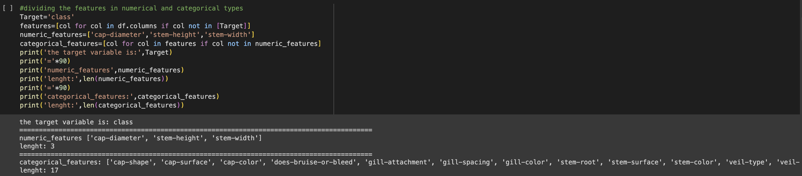
Splitting Data

Slide 10
Data Validation & Cleansing
61,069 rows Multivariate, Edibility prediction
used Pipelines
Column Transformer

Slide 11
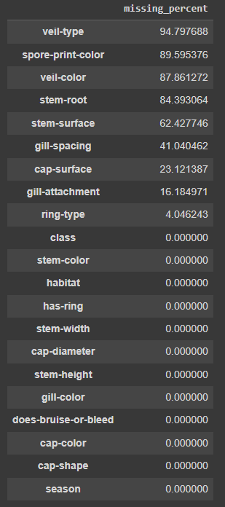
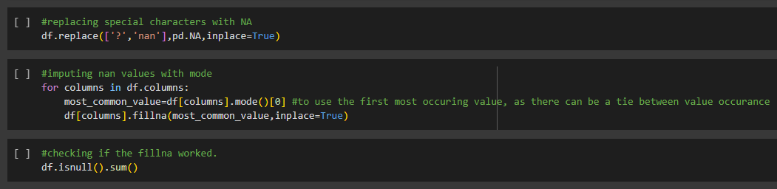
Missing Data Handling
We encountered large percentage of missing values in the data set, along with some special characters like '?, nan'
We took up imputation for handling the missing data

Slide 12
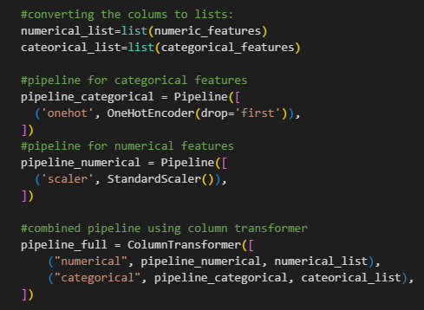
Data Normalization
To pre-process the data for model building we took up the approach of using pipelines.
We created separate pipeline for categorical and numerical features, and integrated those pipelines using a column transformer

Slide 13
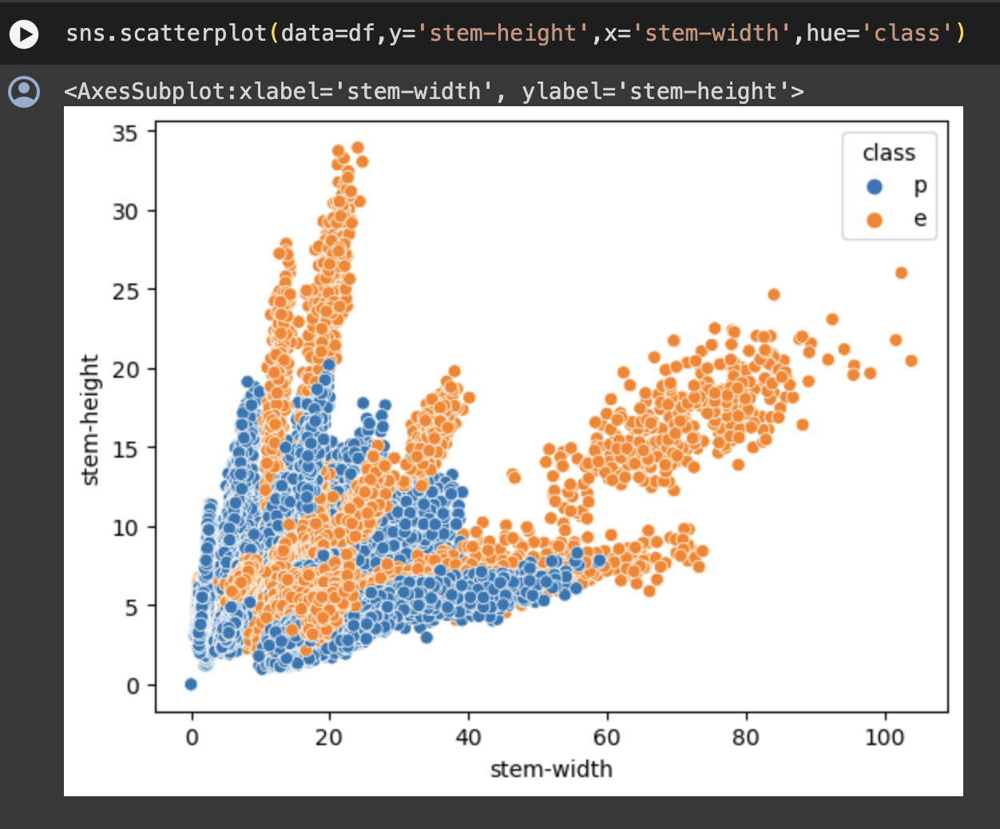
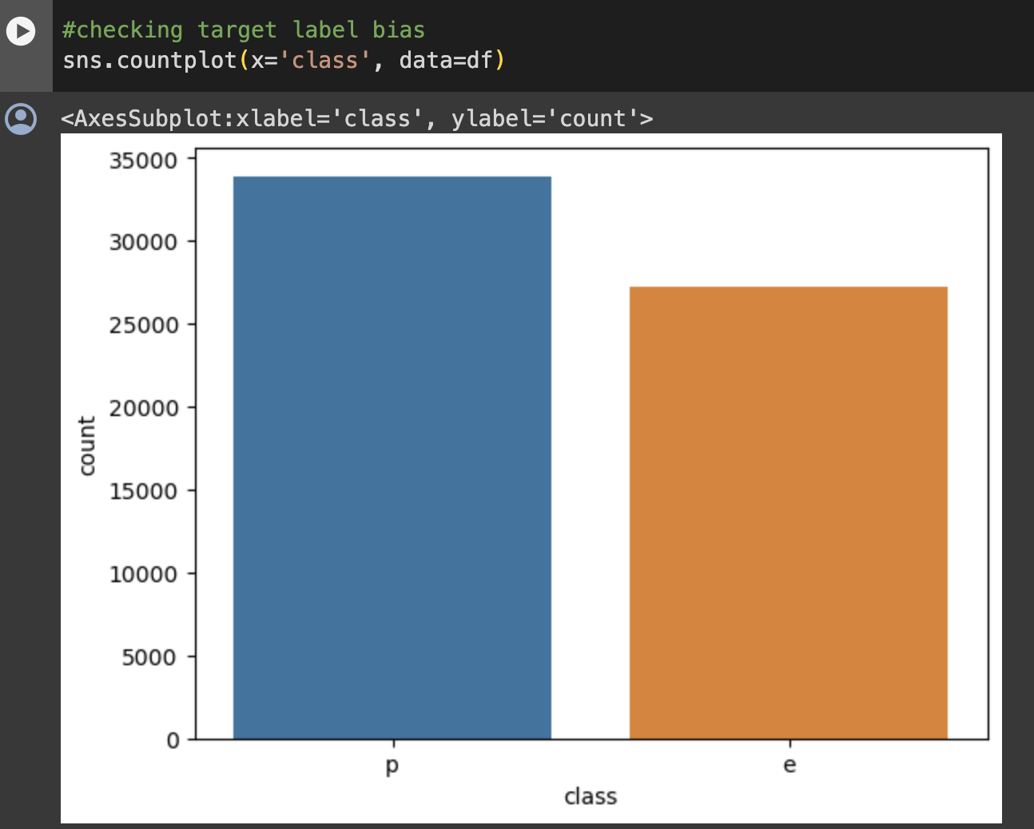
Exploratory Data Analysis

Slide 14
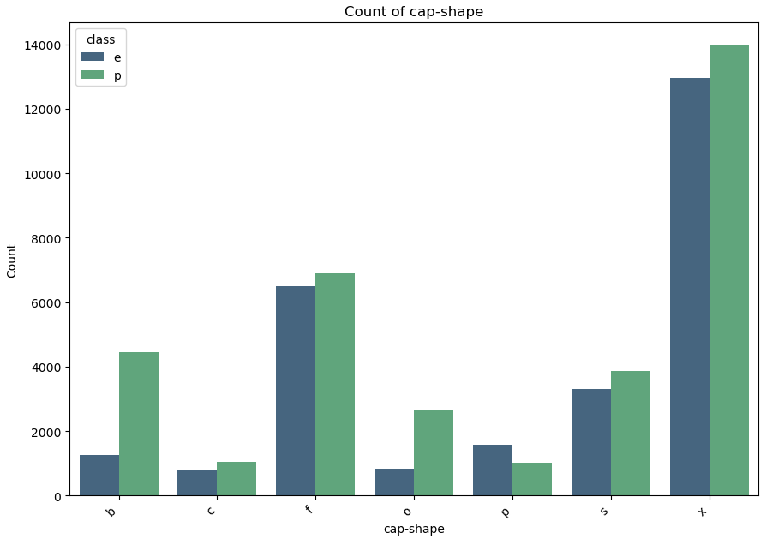
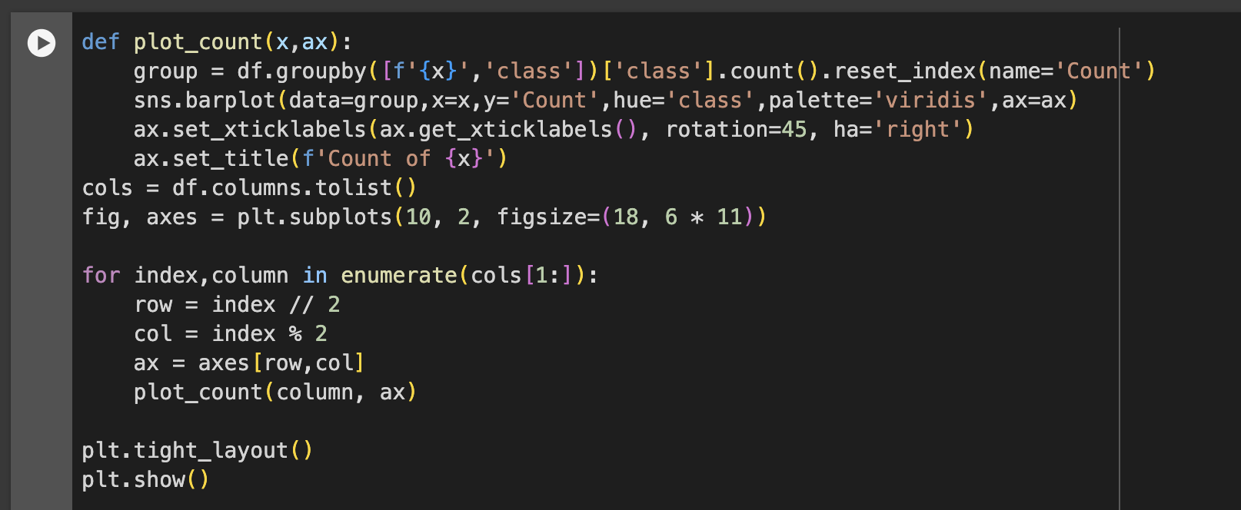
Exploratory Data Analysis

Slide 15
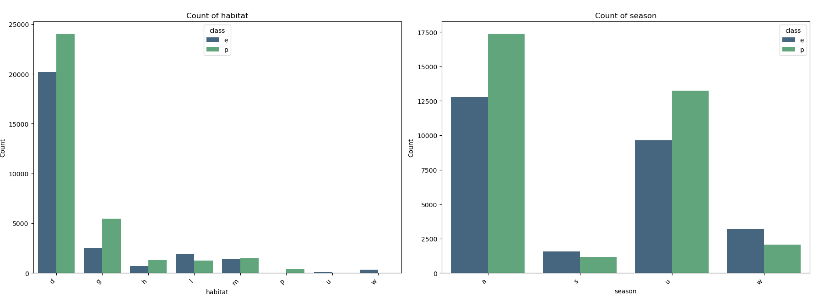
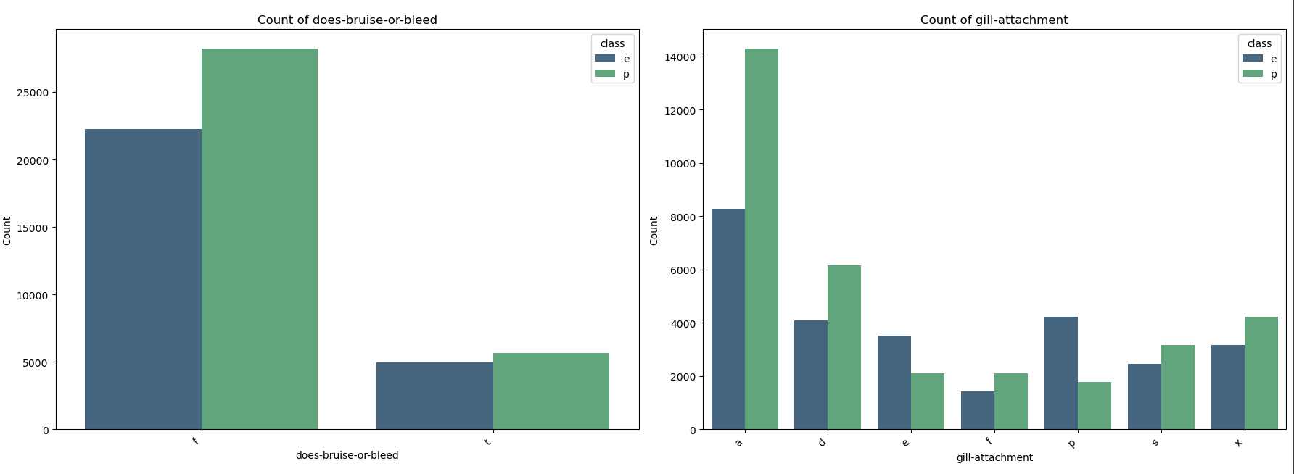
Exploratory Data Analysis

Slide 16
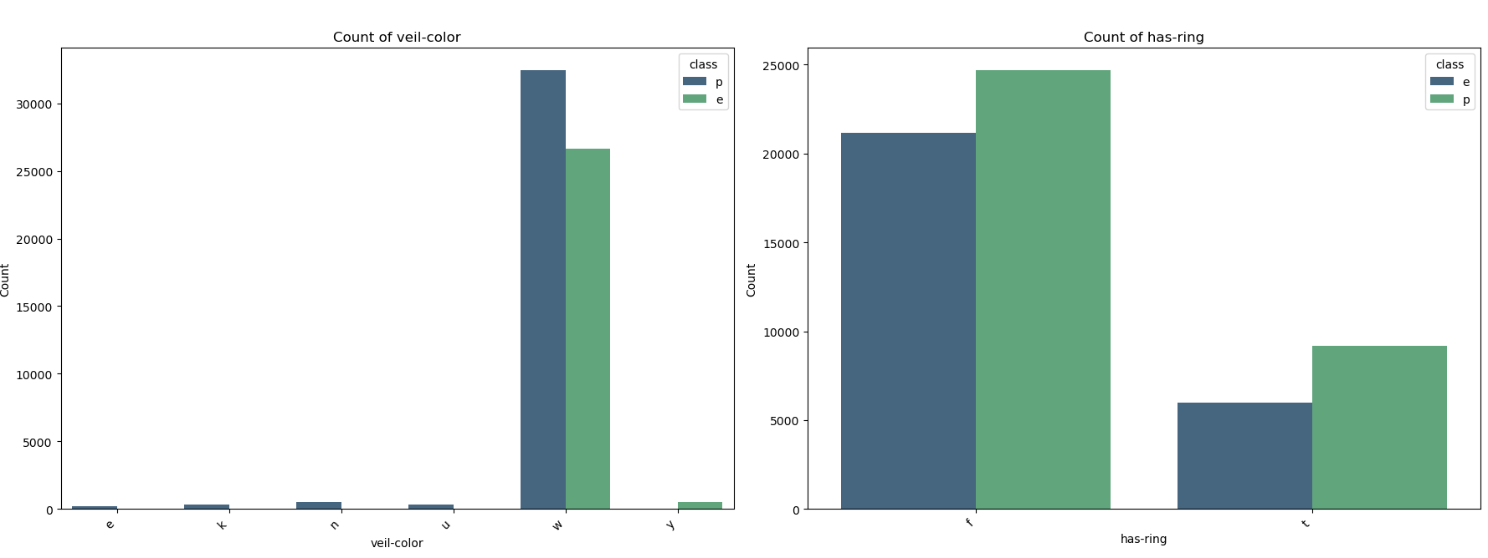
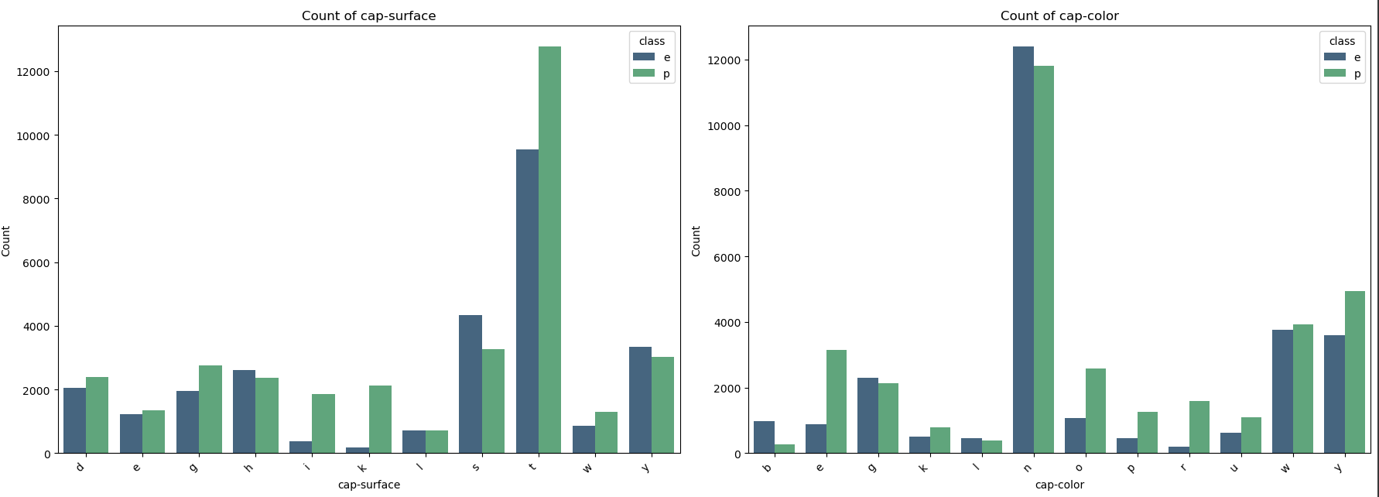
Exploratory Data Analysis

Slide 17
Semi-Supervised Learning
Semi-supervised approach, where characteristics of both supervised and unsupervised learning approaches are inhibited. This is a different approach to train the model, in this case a classifier. First with a smaller portion of labeled data and then a larger portion of unlabelled data. This approach pre-trains the model to understand the inherent data properly.
In our project, We used the last 20,000 records of our primary data set to fit into K-Means Clustering. For this we divided the data into labelled and unlabelled, trained the model on a small set and made predictions for a larger set, we then replaced these 20,000 records with 'Pseudo-labels' and used the now integrated data set for our other models.
Goal of using this approach is to uncover intricate relationship between the features with the target feature and pre-train the model for it, to have better results with the larger original dataset.

Slide 18
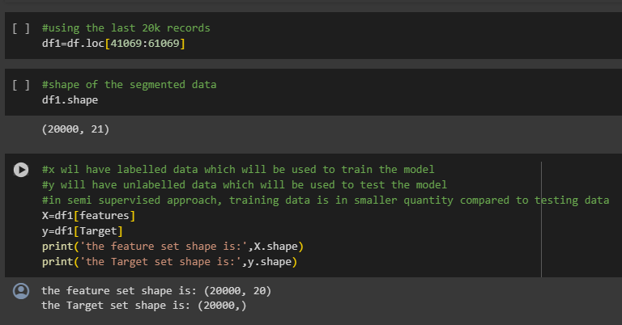
K-Means Clustering
20,000 records of primary data set to fit into K-Means Clustering
We pre-processed the data using pipelines
We then split the data into labelled and unlabelled segments
For semi-supervised approach, we made sure to have a smaller training set and have a larger testing set to have more predicted labels.

Slide 19
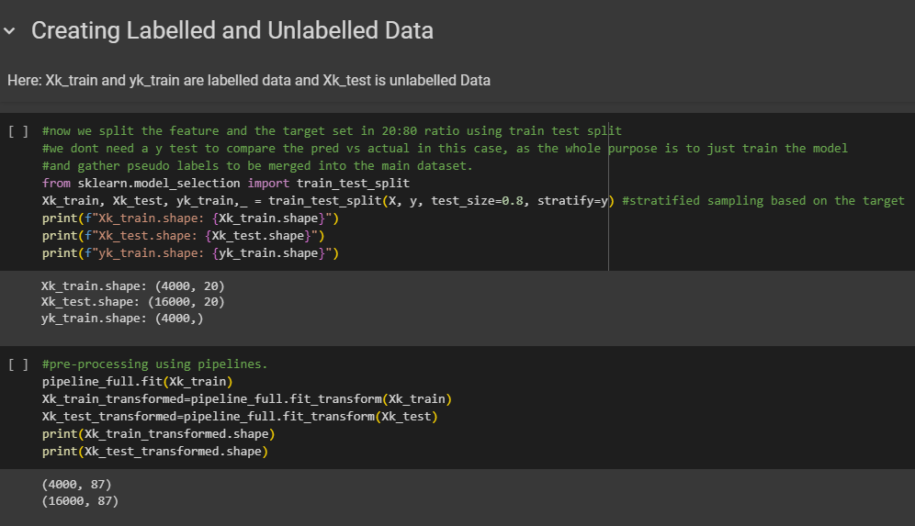
K-Means Clustering
We did not require to use any additional technique to determine the number of clusters as we were dealing with a only 2 classes.
Shape of the data set after the split and preprocessing is shown in this step here.
As we had high number of categorical variables. We ended up generating around 87 columns after pre-processing

Slide 20
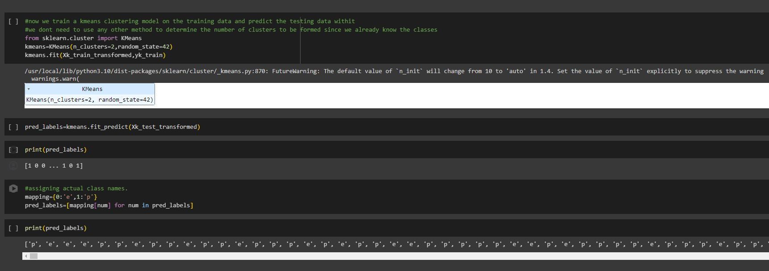
K-Means Clustering

Slide 21
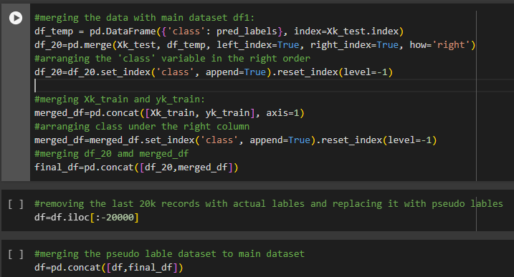
Data Aggregation and Representation
We then predicted the labels, we got an array of 0's and 1's
We mapped the data accordingly and integrated it into the main dataset

Slide 22
Model Building
KNearestNeighbours
Random Forest Classifier
Decision Tree Classifier
Logistic Regression

Slide 23
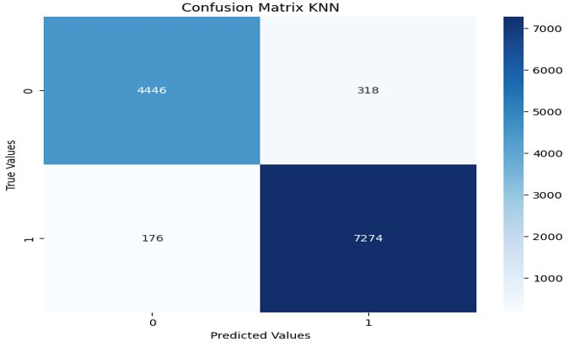
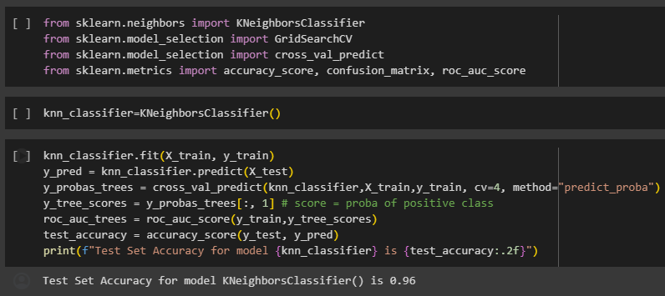
KNearestNeighboursM

Slide 24
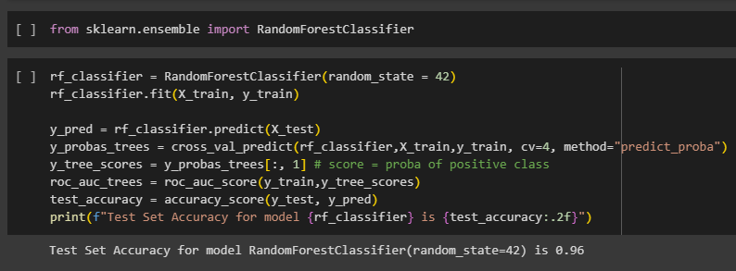
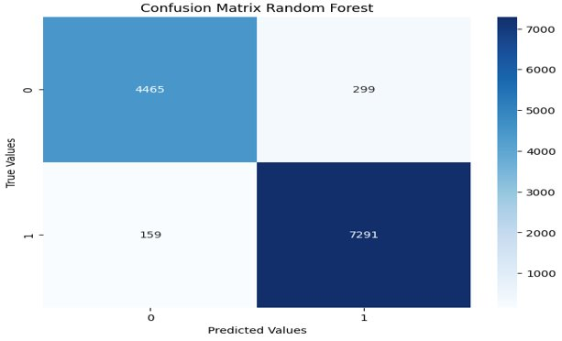
Random Forest

Slide 25
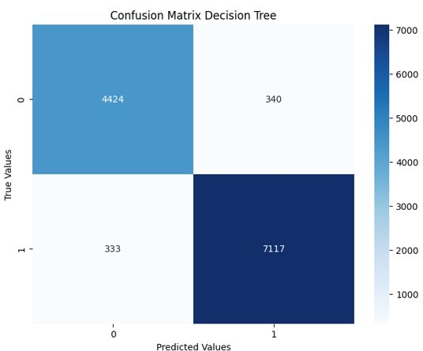
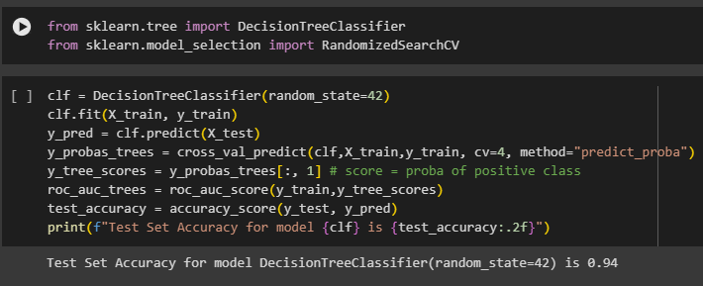
Decision Tree

Slide 26
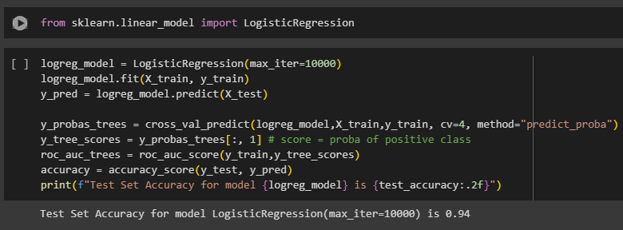
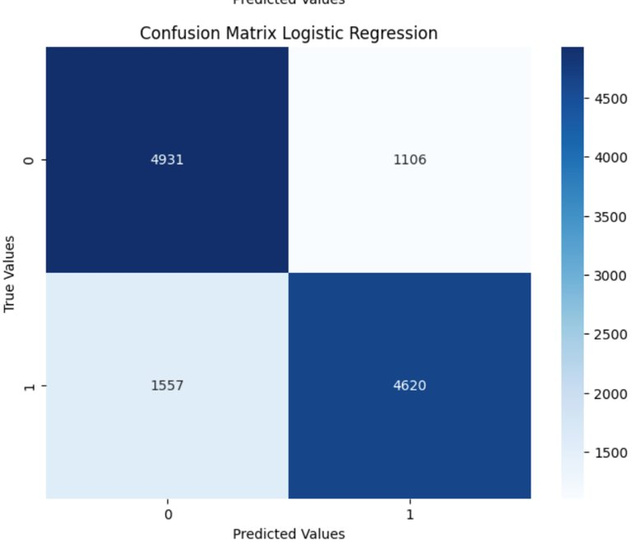
Logistic Regression

Slide 27
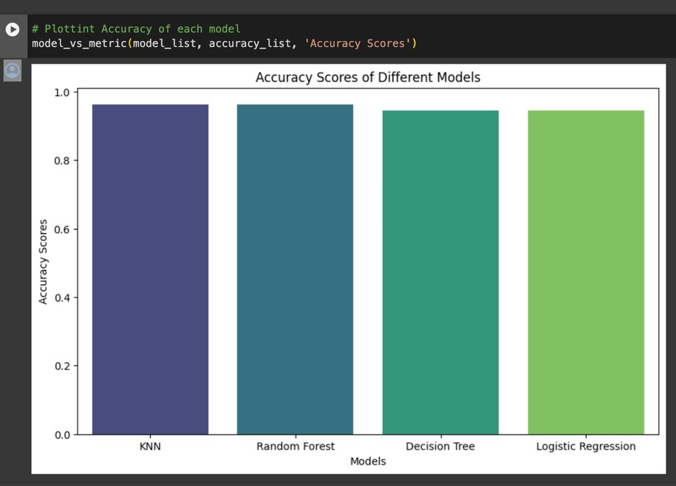
Accuracy Scores of Different Models

Slide 28
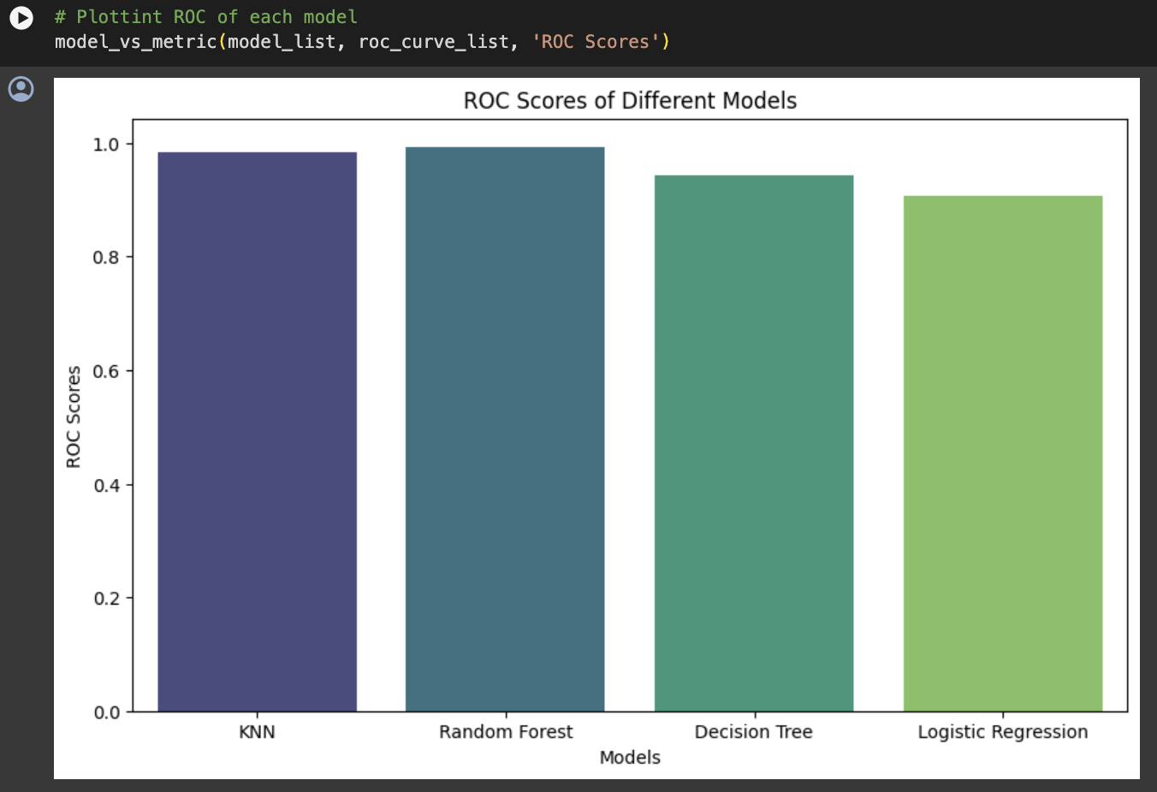
Roc Scores of Different Models

Slide 29
Utilization of Analysis
Data-Driven Decision-Making:
instead of randomly guessing a mushroom to be edible or not, you can take a data backed decision. The model generates valuable insights into the factors influencing the classification of mushrooms. These insights can be leveraged for data-driven decision-making, such as optimizing cultivation practices or adjusting product portfolios.
Market Expansion and Consumer Education:
A reliable classification model can facilitate market expansion by assuring consumers of the safety of the products. It also provides an opportunity for businesses to educate consumers about the importance of choosing safe mushrooms.
Market Differentiation:
A business that can guarantee the safety of its mushroom products through an advanced classification system may gain a competitive edge in the market. It can be positioned as a brand that prioritizes consumer well-being.
Crisis Management:
In the event of a contamination or poisoning incident, having a classification model can enable businesses to quickly identify affected batches, initiate recalls, and communicate with consumers, mitigating the impact on both public safety and the brand.

Slide 30
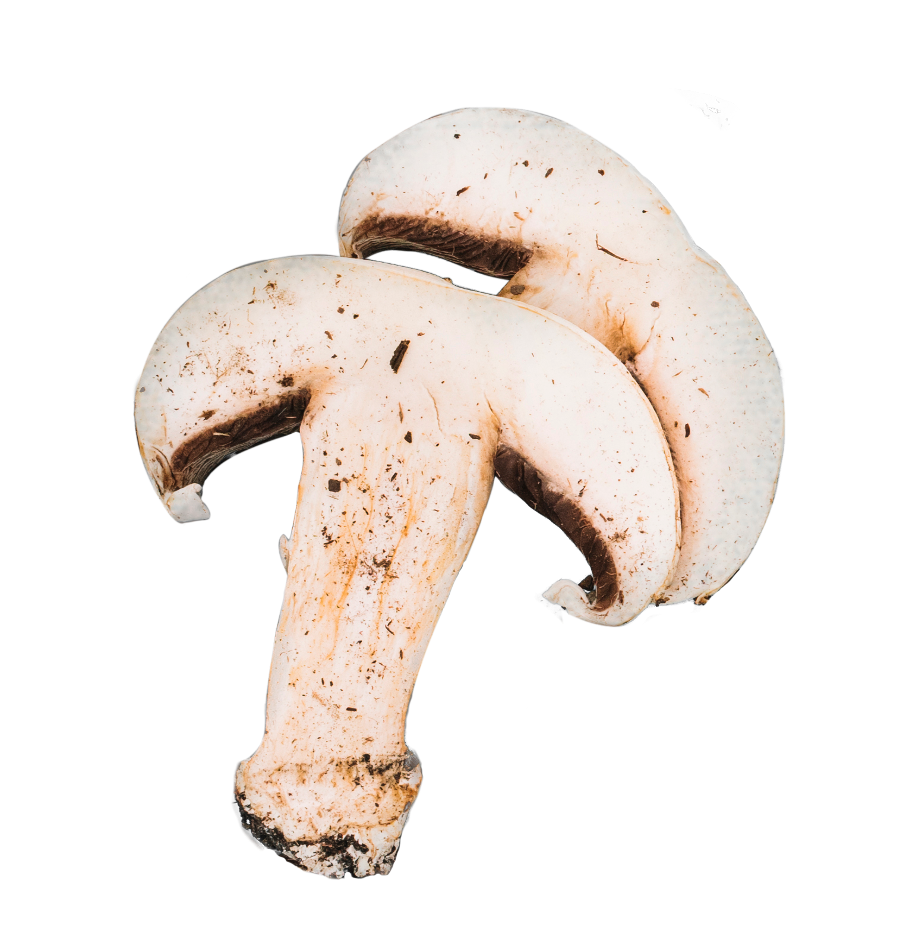
Thanks!
Any Questions?

